Slide 1

Presented by
Abhishek Singh Yadav
MCA4rd Sem (100210706)

Slide 2

List of Content
INTRODUCTON
SYSTEM SPECIFICATION
CHART OF MODULES
STUDY MATERIAL
PREVIOUS YEAR QUSTION PAPERS
EXPERT GUIDENCE
COMMUNITY SUPPORT
PROBLEM FACED
FUTURE SCOPE
CONCLUSION

Slide 3


Slide 4
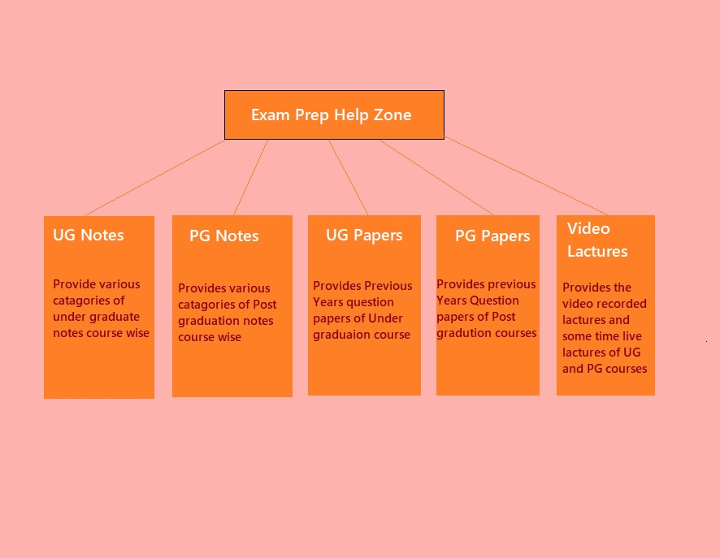

Slide 5
System
Specifications
Processor:
Intel i3
RAM:
256 MB
Hard Disk:
20GB
Monitor:
Color
Operating System:
Windows, Android, iOS
Front end: HTML, CSS, JavaScript
Back end:
MySQL
Server side:
PHP
Server:
Wamp

Slide 6


Slide 7


Slide 8


Slide 9


Slide 10
Problem Faced
1. Limited resources: Developing comprehensive and up-to-date study materials requires substantial time, effort, and expertise. The program may face challenges in ensuring an adequate and diverse range of resources for different subjects and academic levels.
2. Difficulty in engaging students: Encouraging active participation and engagement from students can be a challenge. Some students may not take full advantage of the available resources or fail to actively engage in the online platform or community discussions.
3. Maintaining quality assurance: Ensuring the accuracy, relevance, and quality of the study materials and guidance provided within the program can be demanding. Regular updates, reviews, and quality control measures are necessary to address any potential inaccuracies or outdated information.
4. Technical issues: Technical difficulties, such as website maintenance or platform glitches, can hinder students' access to resources and the online community. These issues need to be promptly addressed to provide uninterrupted support to the students.
5. Sustainability and funding: Securing long-term funding and ensuring the sustainability of the program can be a significant challenge. Without adequate resources and financial support, it may be challenging to maintain the program's operations, updates, and growth over time.
6. Balancing subject coverage: Providing subject-specific assistance across a wide range of academic disciplines can be demanding. Allocating resources and expertise to ensure comprehensive coverage and support for all subjects can be a challenge, particularly in niche or specialized fields.
7. Evaluation and impact assessment: Measuring the program's impact on student performance and satisfaction can be complex. Collecting data and conducting evaluations to assess the effectiveness of the program requires careful planning, data collection methods, and analysis.

Slide 11
Future Scope
1. Integration with online learning platforms: As online learning continues to gain prominence, integrating the Exam Prep Help Zone program with existing online learning platforms can provide a seamless experience for students. This integration can allow students to access exam preparation resources directly within their online learning environment, enabling a cohesive and integrated learning experience.
2. Personalized learning experiences: Leveraging technology, such as artificial intelligence and machine learning, can enable the program to offer personalized learning experiences to students. By analyzing students' performance, study patterns, and individual needs, the program can provide tailored recommendations, adaptive practice exercises, and targeted feedback, enhancing the effectiveness of their exam preparation.
3. Mobile application development: Developing a dedicated mobile application for the Exam Prep Help Zone program can enhance accessibility and convenience for students. With a mobile app, students can access study materials, participate in discussions, and receive guidance on-the-go, providing them with flexibility and ease of use.
4. Collaboration with educational institutions: Collaborating with educational institutions, such as schools, colleges, and universities, can expand the reach and impact of the program. Partnering with educational institutions can enable the program to be integrated into the curriculum, provide additional support to students, and leverage existing academic infrastructure.
5. Expansion into additional languages and regions: Expanding the program's language offerings and reaching students in different regions can increase its accessibility and impact. Translating study materials, offering multilingual support, and catering to the specific needs of diverse student populations can help the program reach a wider audience.
6. Alumni mentorship and networking: Involving alumni as mentors and establishing a network of successful graduates can provide valuable guidance and inspiration to current students. Alumni can share their experiences, career paths, and exam preparation strategies, motivating students and providing real-world insights.
7. Gamification and interactive elements: Introducing gamified elements and interactive components within the program can enhance student engagement and motivation. Gamification techniques, such as earning badges or rewards for completing study milestones, can make the learning process more enjoyable and encourage students to actively participate.
8. Research-based strategies: Collaborating with educational researchers and incorporating evidence-based strategies can enhance the program's effectiveness. Staying updated with the latest research on effective study techniques, cognitive processes, and learning methodologies can ensure that the program aligns with best practices in exam preparation.

Slide 12


Slide 13


